Slide 1
The Metaphysical Foundation of The Three Theories of Moral Anti-Realism: Amoral Physicalism or Biologicalism
Dr. Ducharme
Classroom PowerPoint

Slide 2


A Question: What am I, What are we? (Also, how do we know the answer to this question?)
Three Answers:
Physical, biological, sentient things
Biological Social Things, Social Constructions
Sentient Careful Calculating things

Slide 3
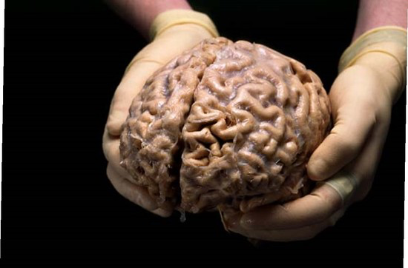
Moral Anti-Realism 1: Ethical Egoism

Slide 4
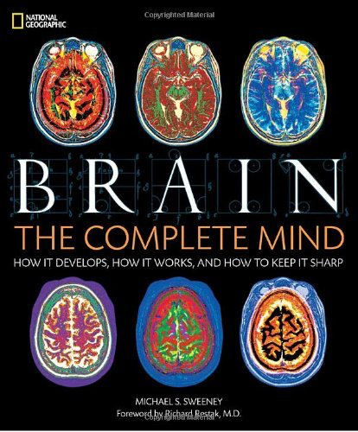
Physicalism = The Brain = The Complete Mind

Slide 5
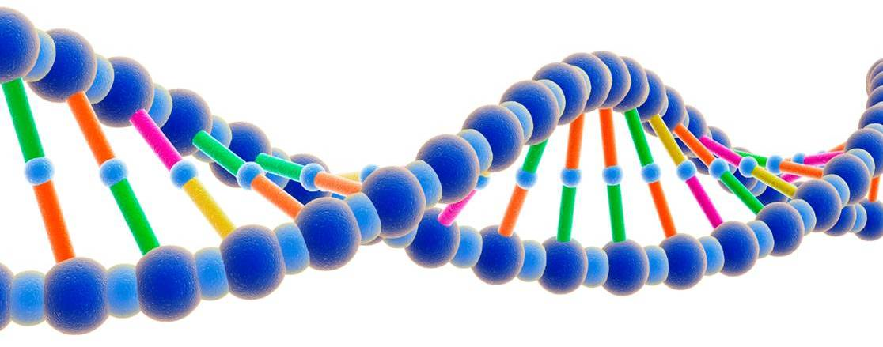
Human Nature Reduces to Human Genetic Code: The 98.4% Chimp DNA Argument (Peter Singer, et al):
Philosophical Claims: “We are Chimps”, “Chimps are People, too!”, “Science Proves It!”

Slide 6
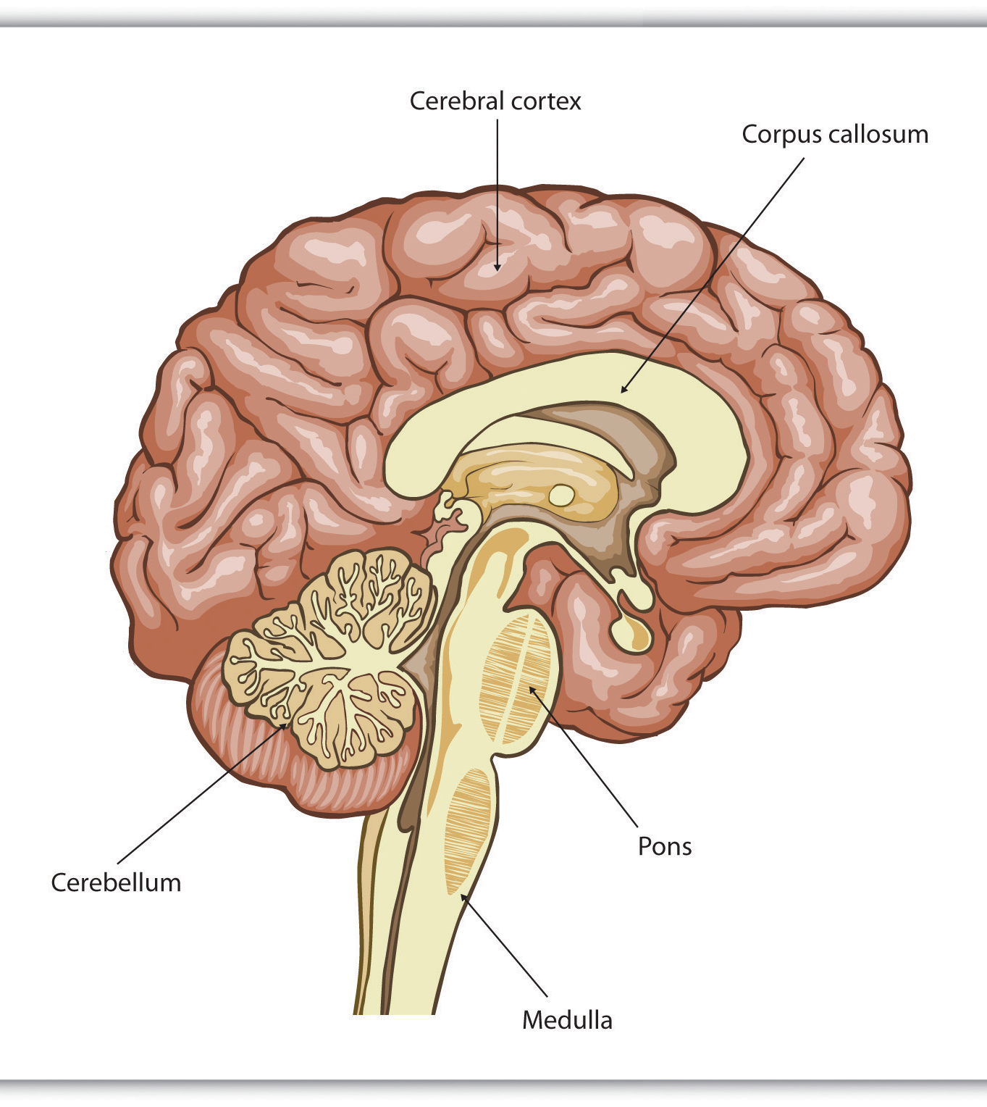
Contemporary Psychology & Neuropsychology Axiom:
“The mind is the brain.”
“The Cerebral Cortex Creates Consciousness and Thinking”
The quotation above is from Introduction to Psychology, v. 1.0, by Charles Stangor (Univ. of Maryland)
  http://catalog.flatworldknowledge.com/bookhub/127?e=stangor-ch03_s02
“Our Brains Control Our Thoughts, Feelings, and Behavior”
The mind is the brain (Dennett, Martha Farah, Sam Harris, etc.). Thinking and consciousness = cerebral cortex brain activity.
[Personalism by contrast, argues that the activities of the mind = irreducible self-conscious moral agent, that we have direct, private, knowledge of our mental life; that consciousness and thinking are activities of the mind, invisible = non-physical or immaterial substance; it argues that the mind is not the brain; rather, in a living human being, the mind interacts with the physical brain. Refutation: if mind = brain, then introspection would show me nerve impulses in a 2 ½ pound gray highly convoluted soft tissue, surrounded by a highly oxygenated bloodbath.]

Slide 7
Moral Anti-Realism 2: Moral or Cultural Relativism – The Blank Slate Theory

Slide 8
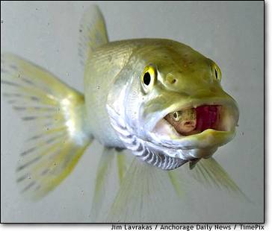
Moral (and Cultural) Relativism:
Morality is Learned
I = Blank Slate + Culture (Secular or Religious) Engraves its Values into Us
I = Silly Putty + Culture (Secular or Religious) Molds me into its image
Secular Forms:
Emile Durkheim, Founder of Sociology, et al:
Metaphysical assumption: “Individual natures are merely the indeterminate material [blank slates] that the social factor molds and transforms…[human beings have] plastic dispositions.” Durkheim
Franz Boas: “civilization is not something absolute, but ... is relative, and ... our ideas and conceptions are true only so far as our civilization goes.” (Science 9:589, 1887)
“Instincts do not create customs; customs create instincts…always learned and never native.” Ellsworth Faris (1927)
“Man has no nature; what he has is history.” Jose Ortega y Gasset (1935)
“Our ideas, our values, our acts, even our emotions, are, like our nervous system itself, cultural products…” Clifford Geertz (1973)
Basic belief (metaphysical assumption, theory of mind): We are “social constructs” = we are blank slates at birth and become what our society makes us
Examples of Social Constructs that are transmitted: Race, Tribal (Hutu, Toutsi), Economic Class (Rich, Middle Class, Poor), Caste (Dalit or Brahmin; Aristocracy, Commoner), Gender (distinguished from your biological sex), Nationalism (Us, them), etc.

Slide 9
Customs Create Instincts; Social Conditioning is Stronger then Biological Instincts

Slide 10
Illustration: Principles of Sociology (textbook) http://www.soc.iastate.edu/sapp/soc235basics.html
What is Sociology?
Sociology is the scientific study of human populations. The central premises listed below describe the sociological perspective. This perspective provides a way of viewing the world that helps scientists understand society and improve the well-being of the people who live in the society. It is not the only way of viewing society. The other social sciences--political science, anthropology, economics, and psychology--also provide frames of reference for improving society and the health and well-being of its members.
These are the basic principles of sociology:
People behave differently in groups than they do as individuals.
People obey rules that are socially constructed.
People socially construct the rules.
Some people have more say-so than others in making the rules.
There are rewards for following the rules and penalties for breaking the rules.
The rules of society can be studied scientifically.

Slide 11
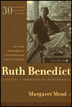
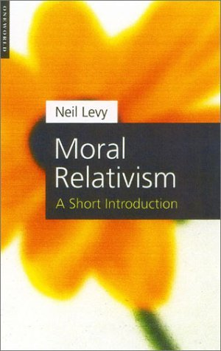
Basic Argument for Cultural Relativism
See Ruth Benedict (a student of Franz Boas) in Rachels, Elements
“We are what our genes and environment make us.” But morality is the product of cultural conditioning; it is not innate. We are amoral “blank slates” at birth.
We do not have direct knowledge of the world; all of our experiences of the world are mediated through an interpretive paradigm, which structures perceptions according to socially constructed set of a priori concepts. “There are no facts (no moral facts) per se; just interpretations (of behavior).” (Evidence: the Rabbit/Duck; Hag/Woman Images)
3. Culture = any characteristic set of mental and physical reactions, beliefs and values that characterize the behavior of individuals constituting a social group; spread by language and tradition; a paradigm, a worldview; the glasses through which we see, interpret and understand reality. Our own beliefs and activities are culture bound, not “natural” or universal. (See Boas, The Mind of Primitive Man, 1911, p. 149)
4. Morality = socially learned and constructed beliefs that mold human behavior; we see morality in and through the paradigm/glasses given to us by enculturation.
“Right” = any and every socially approved behavior
“Wrong” = any and every socially disapproved behavior
“Objective” standards exist but only within a culture; there is no trans-cultural, universal moral standard across all cultures.
5. Benedict: Morals do not exist, only customs (socially constructed paradigms; worldviews) exist.
6. There is no universal objective standard of ethics because there is no paradigm-free or trans-culture objective knowledge of reality.
7. Therefore, (a) we ought not to be arrogant about our ethical views, and (b) we all ought to be tolerant.

Slide 12
Moral Anti-Realism 3: Utilitarianism

Slide 13

Analytic Outline of Bentham’s Axiom of Nature
(A Self-Evident, Unsupported Axiom/Claim)
“Nature has placed mankind under the governance of two sovereign masters, pain and pleasure.
It is for them alone to point out what we ought to do, as well as to determine what we shall do.
On the one hand the standard of right and wrong, on the other the chain of causes and effects, are fastened to their throne.
They govern us in all we do, in all we say, in all we think …

Slide 14

Utilitarianism in Everyday Maxims
“We all should work together to make this a better world to live in, wouldn’t you agree?”
“How would you like someone to do that to you?”
“Do onto others as you would have them do to you.”
  (Golden Rule = Utilitarianism?)
“You can’t make everybody happy all the time.”
The purpose of life is to make this a better place to live.”
“Always do the lesser evil.”
“Always to the greater good.”
“The end justifies the means.”
“Don’t just stand there, make yourself useful.

Slide 15

Opening Paragraph, The Principles of Morals and Legislation (1780/1789): Nature and the Principle of Utility
“Nature has placed mankind under the governance of two sovereign masters, pain and pleasure. It is for them alone to point out what we ought to do, as well as to determine what we shall do. On the one hand the standard of right and wrong, on the other the chain of causes and effects, are fastened to their throne. They govern us in all we do, in all we say, in all we think …By the principle of utility is meant that principle which approves or disapproves of every action whatsoever according to the tendency it appears to have to augment or diminish the happiness of the party whose interest is in question: or, what is the same thing in other words to promote or to oppose that happiness. I say of every action whatsoever, and therefore not only of every action of a private individual, but of every measure of government.”
(emphasis added)

Slide 16

Bentham’s Argument Part II: The Felicific Calculus
(aka, The Happiness Calculus, The Hedonistic Calculus; Doing Moral Mathematics)
How to Calculate Right/Wrong to All Effected = Use the 7 Modes of Pains and Pleasures and Solve Any and Every Decision
Intensity: How strong is the pleasure?
Duration: How long will the pleasure last?
Certainty or uncertainty: How likely or unlikely is it that the pleasure will occur?
Propinquity or remoteness: How soon will the pleasure occur?
Fecundity: The probability that the action will be followed by sensations of the same kind.
Purity: The probability that it will not be followed by sensations of the opposite kind.
Extent: How many people will be affected?
  http://en.wikipedia.org/wiki/Felicific_calculus

Slide 17
There Are Two Kinds of Moral Theories:
Moral Anti-Realism (3 Versions) and Moral Realism (2 Versions)
The 3 Versions of Ethical Anti-Realism (aka, Physicalism, Biologicalism, Ethical Naturalism)
Ethical Egoism = morality reduces to naturalistic self-interested wants and desires
  Right = whatever satisfies my wants, interests, desires
  Wrong = whatever frustrates my wants, interests, desires
Moral Relativism = morality reduces to social norms, religious norms, ethnic, LGBT group norms
  Right = whatever is socially approved by the social group or the tradition
  Wrong = whatever is socially disapproved by the social group or the tradition
Utilitarianism = morality reduces to the Principle of Utility: always act so as to produce the greatest amount of happiness for the greatest number of sentient beings (pain and pleasure), in the long run.
  Right = whatever maximizes happiness for the greatest number affected in the long run
  Wrong = whatever does not maximize the happiness of the greatest number affected…
  The 2 Versions of Ethical Realism
Deontology = Always treat a person (moral agents, SCMAs) with intrinsic moral value (do not treat a person as a mere “thing” or like “dirt” or with cruelty); act on moral duty to keep objective moral principles toward persons
  Right = Doing one’s objective moral duty for duty’s sake, e.g., Do not kill, Tell the truth, Do what is just, etc.
  Wrong = Treating others as mere means to an end, as things, rather than as beings of intrinsic value, e.g., to kill to harvest organs and make money and save lives of others; to lie is to intentional deceive someone for ulterior, hidden egoistic purposes
Virtue Ethics = “Your message is -- your life,” be a moral light and guardian of life; attend to overcoming self-centeredness and bias -- and developing the interior moral qualities of the virtues -- the life of the mind; go beyond mere external behavior performance; inner peace in one, in many = peace in the world; rightly ordered loves, includes a Transcendent moral hierarchy (God, Brahman, Dao, Nirvana), gives one a rightly ordered life; disordered loves (self-centeredness, vices, addictions) produce disordered lives.
  Right = Being compassionate, just, fair, benevolent, morally courageous, truthful (the virtues)
  Wrong = Being slothful, greedy, deceptive, dishonest, unreliable, egoistic (the vices)

Slide 18
The 5 Moral Theories Rest Upon
Competing Theories of the Essential Nature of a Human Being
The Theories of Moral Anti-Realism:
Metaphysical Base of Physicalism (Ontology) and Perceptions using the 5 Physical Senses of the External Physical World (Epistemology)
(aka, Ethical Anti-Realism, Reductivism, No Innate Moral Nature, No intrinsic Moral Value)
Ethical Egoism: We are essentially sentient biological organisms driven by desires, wants, interests and fear (survival instincts seeking survival).
Moral Relativism: We are essentially social, relational beings -- “blank slates” at birth, “silly putty” under the forces of social (cultural) determinism, seeking social harmony.
Utilitarianism: We are essentially sentient and rational biological beings seeking to maximize happiness for all affected by decisions
The Theories of Moral Realism:
Metaphysical Base of Personalism (Persons exist and are irreducible entities, SCMAs, Real Minds[Ontology] and 1st-Person, Direct Knowledge of the Mind, SCMAs [Epistemology])
(aka, Ethical Anti-Naturalism, Non-Reductivism, Innate Moral Nature, Intrinsic Moral Value)
Deontology: We are essentially persons, embodied self-conscious moral agents (person = mind = carries on the activities of SCMA (person or soul); our moral minds discern the moral structure and laws of the moral realist just as the physical laws govern the physical world. Thus we experience and understand the constraints of objective universal moral duties; under moral obligations to do what is right and not what is wrong.
Virtue Ethics: We are essentially embodied self-conscious moral agents seeking freedom from self-centeredness and seeking objective universal moral virtue, moral perfection, or harmony with the ultimate Moral Reality or God.

Slide 19
The 5 Moral Theories
Ethical Egoism = Morality reduces to the biological fact that we are essentially biological organisms, driven to survive by wants, interests, and desires; morality just is (reduces to) our naturalistic self-interested wants and desires.
Moral Relativism = Morality reduces to the fact that we are essentially social beings; “morality” = socialization = external conditioning by environments of social norms, religious norms, ethnic, LGBT group norms, political party norms, nationalistic norms, et al.
Utilitarianism = Morality reduces to the fact that we are rational and sentient beings; morality = reason using the Principle of Utility (calculating sums of pains and pleasures to all affected), reason calculating future consequences of possible actions, i.e., always act so as to produce the greatest amount of happiness for the greatest number of sentient beings (pain and pleasure), in the long run.
Deontology = Morality is an irreducible moral fact of persons, persons are essentially self-conscious moral agents (SCMAs, an irreducible moral conscience, the moral nature of the mind), bearers of intrinsic moral worth, which requires that we recognize others (and ourselves) as SCMAs, and always act according to our moral duty, i.e., treating persons (SCMAs) with intrinsic moral value (contra treating persons as merely useful or useless things); requiring action on objective, universal moral duties, objective moral principles: Do not harm, Do not kill, Tell the truth, Be just, Do good.
Virtue Ethics = Morality is an irreducible moral fact of persons (SCMAs, moral conscience, the moral nature of the mind), where one’s moral character (not one’s mere words) is one’s primary project and message to others; attention to actually developing virtue character traits (kindness, benevolence, justice, self-control, altruism, truthfulness, wisdom, patience), rightly ordered “loves”, overcoming “addictions” to biological wants, desires, and lusts, and other human universal first-person dis-orders -- of self-centeredness, vices, addictions, tribalism, social conditioning, and cold, calculating utilitarian rationality – all of which produce disorder in one’s inner personal life and conflicts with others.

Slide 20
What is Empiricism, How Do Gain Knowledge of What Exists?
Answer from a Classic Empiricist, John Locke: Knowledge can be gained by the physical senses of external physical objects and by direct self-consciousness of oneself or person
“Real existence can be proved only by real existence; and, therefore, the real existence of a God can only be proved by the real existence of other things. The real existence of other things without us [external objects] can be evidenced to us only by our senses [3rd person observations using the 5 physical senses]; but our own existence is known to us by a certainty yet higher than our senses give us of the existence of other things, and that is internal perception, self-consciousness, or intuition[direct, 1st person knowledge of our person or mind]; from whence therefore may be drawn, by a train of ideas, the surest and most incontestable proof of a God.”
(Locke 1972: 316. Quoted from Robert Meyers, Understanding Empiricism, [2014] p.1)

